Slide 1
LSTM-BASED APPROACH FOR GENERATOR STATE PREDICTION IN TRANSIENT STABILITY ASSESSMENT AND CONTROL USING TRANSIENT ENERGY FUNCTION
Presented By:
Bhupesh Jaishi (078BEL026)
Binod Kumar Sah (078BEL030)
Bishal Chaurasiya (078BEL031)
Chandan Sah (078BEL032)
DEPARTMENT OF ELECTRICAL ENGINEERING
IOE, PULCHOWK CAMPUS

Slide 2
Introduction
Transient instability can cause blackouts after severe faults like line to line fault.
Work is based on the paper “Real Time Prediction and Control of Transient Stability Using Transient Energy Function”
Two phases Offline and Online for computation and simulation is discussed
Need: fast, reliable prediction of generator states (speed & angle) for load shedding purpose
LSTM offers time-series learning ability suitable for dynamic system response

Slide 3
Objectives
To develop and implement an LSTM (Long Short-Term Memory) neural network model for accurate, real-time prediction of generator angles and speeds in the IEEE 9-bus system following a fault
To demonstrate the applicability of the enhanced TEF method on the IEEE 9-bus test system

Slide 4
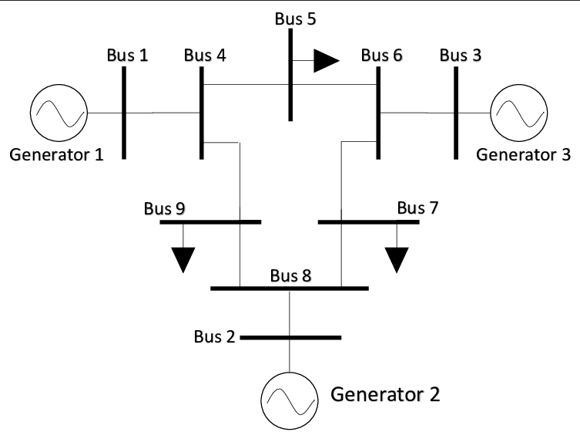
IEEE-9 BUS SYSTEM

Slide 5
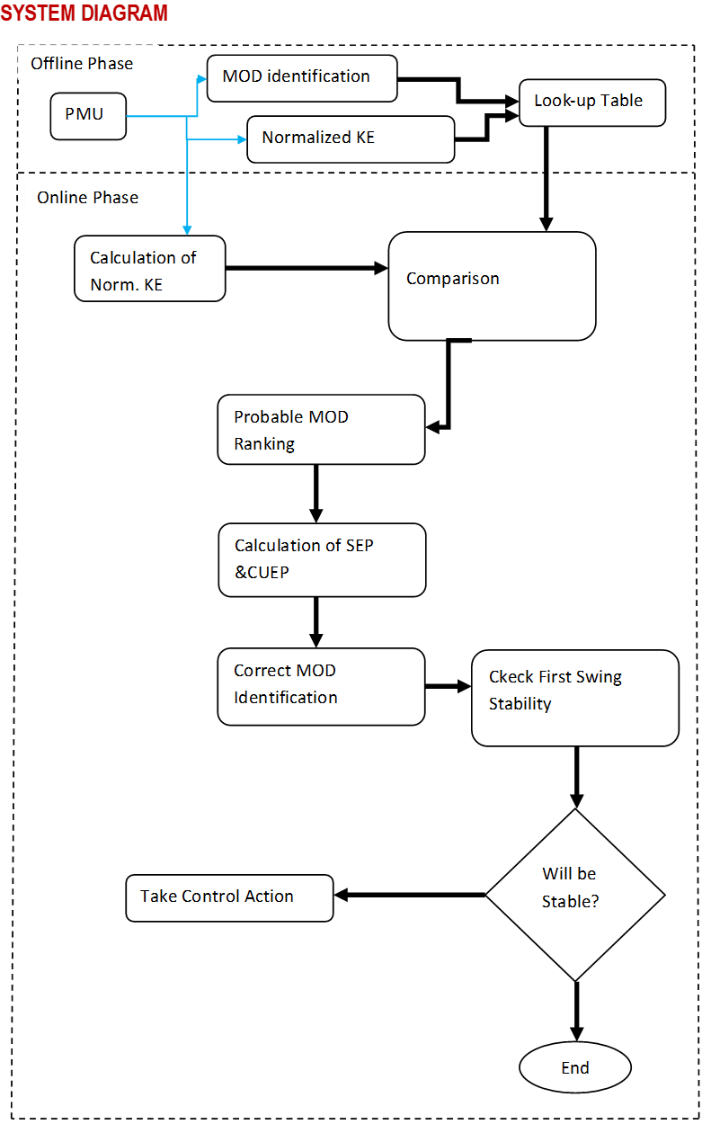
METHODOLOGY
No
Yes

Slide 6
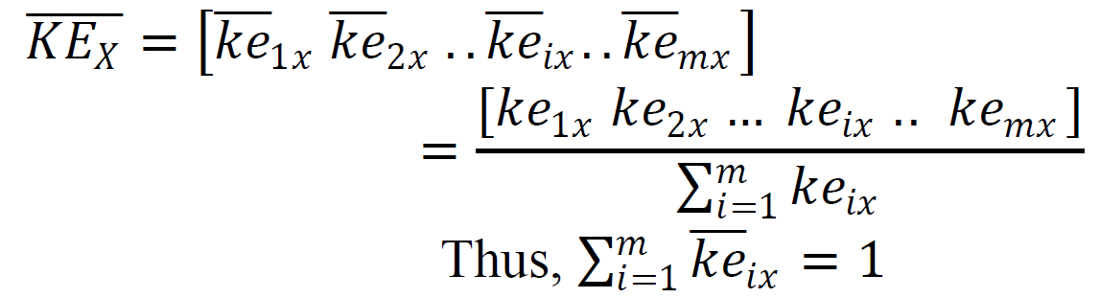
a) MOD identification for different fault location
Offline Phase
For a fault at a location "X", if generator i and j go out of step, the MOD is 𝑀={𝑖,𝑗}.
MOD | Fault Location
M1={1 2 3} | Line: 4-5
M2={2} | Bus: 2
b) Computation of normalized KE gained by the generators
[1] P. Bhui and N. Senroy, "Real Time Prediction and Control of Transient Stability Using Transient Energy Function," IEEE Trans. Power Syst., doi: 10.1109/TPWRS.2016.2564444.

Slide 7
Online Phase: Computation Using PMU Data
a) Correct MOD Identification:
Step 1: Calculation of 𝐾𝐸 - Calculate the 𝐾𝐸 from the generator speeds obtained from the PMU data.
Step 2: Ranking of Probable MODs
The MOD depends on the distribution of kinetic energy gained by generators during a fault and as well as the post fault topology. Using kth Nearest Neighbour (k-NN) method Is used to find the most probable MOD
Step 3: Calculation of Post-fault SEP (Stable Equilibrium Point)
Step 4: Calculation of CUEP( Controlling Unstable Equilibrium Point)
Step 5: Identification of the Correct MOD

Slide 8
Online Phase: Computation Using PMU Data
b) Assessment of first swing transient stability:
c) Estimation of the Amount of Control Actions Required and Monitoring of Stability Status
Prediction of generator speed and angles (we will be using LSTM for prediction):
Modification in Energy Function for Generation Shedding:
Estimation of the amount of control actions required:

Slide 9
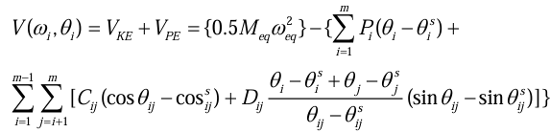
Transient Energy Function(TEF)
It describes the total system transient energy for the post disturbance system.
Based on the data obtained from PMU the TEF is calculated using.

Slide 10
Our Contribution
Introduction of LSTM Based prediction of generator speed and angle to determine the control action.
LSTM will be trained using the data of PMU at different fault condition at different interval of time.
When using online LSTM predicts the speed and angle of each generator and provides us the required control action to to taken.

Slide 11
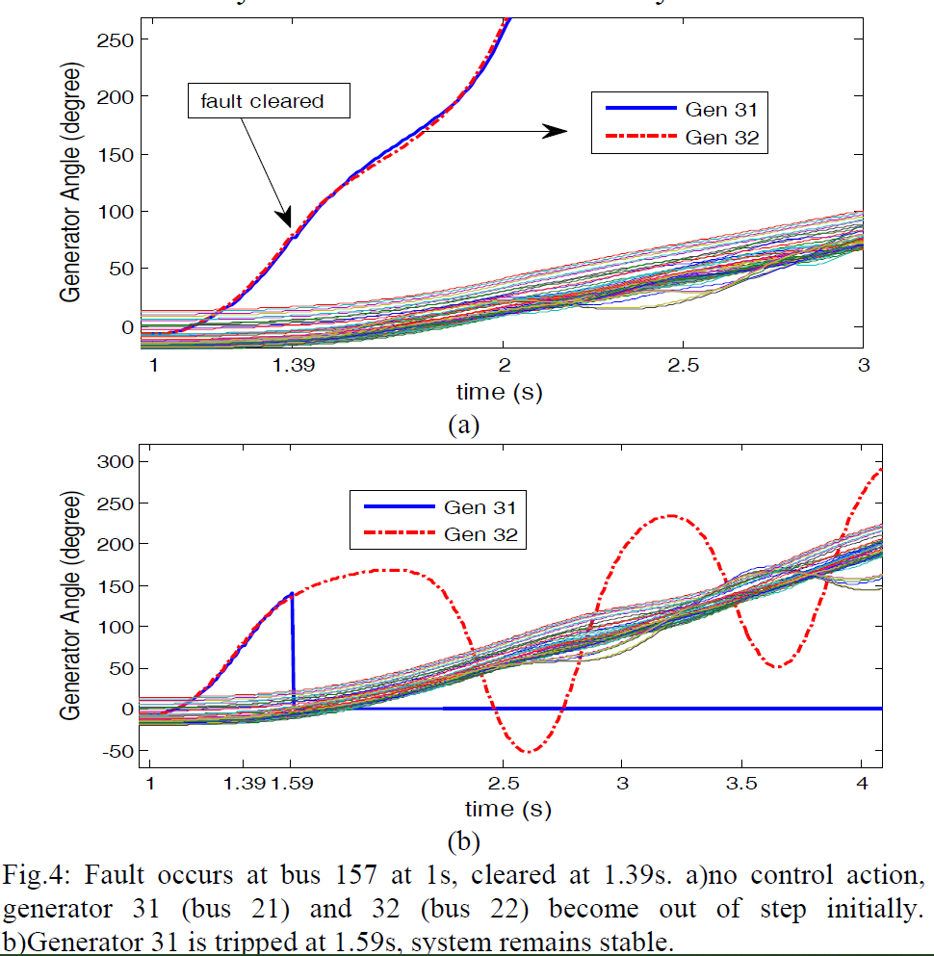
Expected Result

Slide 12
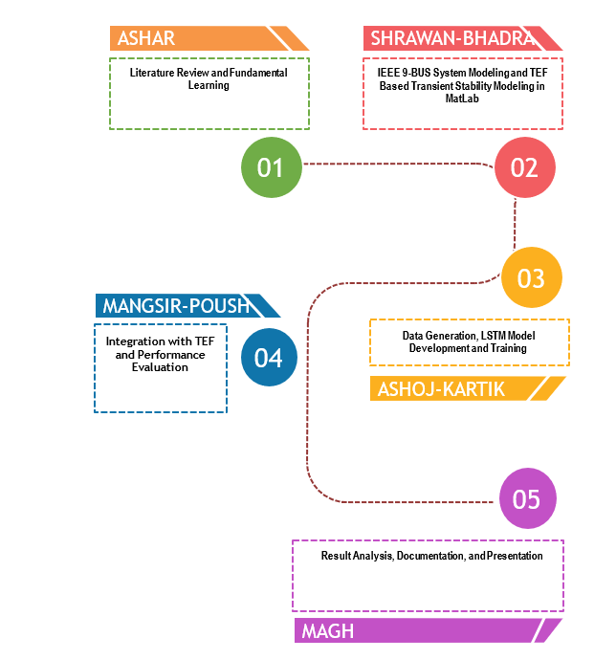
Schedule

Slide 13
References
[1] P. Bhui and N. Senroy, "Real Time Prediction and Control of Transient Stability Using Transient Energy Function," IEEE Trans. Power Syst., doi: 10.1109/TPWRS.2016.2564444.
[2] F. Silva-Rodriguez, H. Raffoul, and Y. Li, “LSTM-Based Net Load Forecasting for Wind and Solar Power-Equipped Microgrids,” in Proceedings of the 2024 IEEE Power & Energy Society General Meeting (PESGM), Seattle, WA, USA, Jul. 2024, pp. 1–6. doi: 10.1109/PESGM56776.2024.1234567.
[3] G. Van Houdt, C. Mosquera, G. Nápoles, “A review on the long short term memory model,” Artificial Intelligence Review, vol. 53, pp. 5929 5955, 2020.
[4] H. D. Chiang, F. Wu and P. Varaiya, “A BCU method for direct analysis of power system transient stability,” IEEE Trans. Power Syst., vol. 9, pp. 1194–1208, Aug. 1994.

